Slide 1

Finding the Best Place to Open A Restaurant

Slide 2
Instruction
Background
The research focus on the neighborhoods of New York City and Toronto, two of the most important financial and cultural cities in North America. I will analyze the features of the neighborhoods of these two cities, and find the best place to open the restaurant.
Data Source
I will use the location data of New York and Toronto provided in Module 3, and use Foursquare API to get the features of the neighborhoods.

Slide 3

Methodology
Clustering, Segementation, Data Visualization

Slide 4
Methodology
(1) Scrape the raw data of the neighborhood of Toronto online. Load the data into a table, clean the data, and get the coordinates of each neighborhood.
(2) Get the information of the venues of all neighborhood, find out the top 10 most common venues of each neighborhood
(3) Segment and cluster the neighborhood into 5 clusters

Slide 5
Methodology
(4) Visualize the resulting clusters
(5) Find the best place to open a restaurant in Toronto
(6) Conduct a similar process to find the best place to open a restaurant in New York
(7) Compare the 2 places above and find the better one to open a restaurant

Slide 6

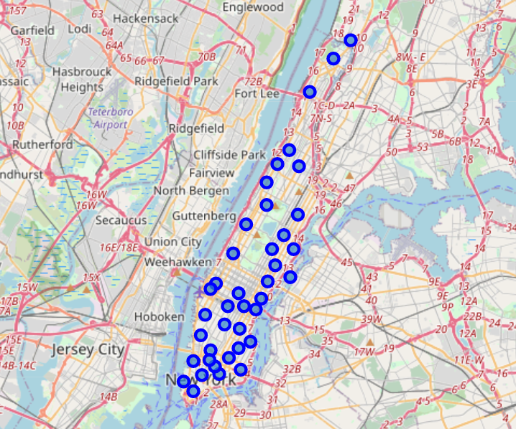
New York City

Slide 7
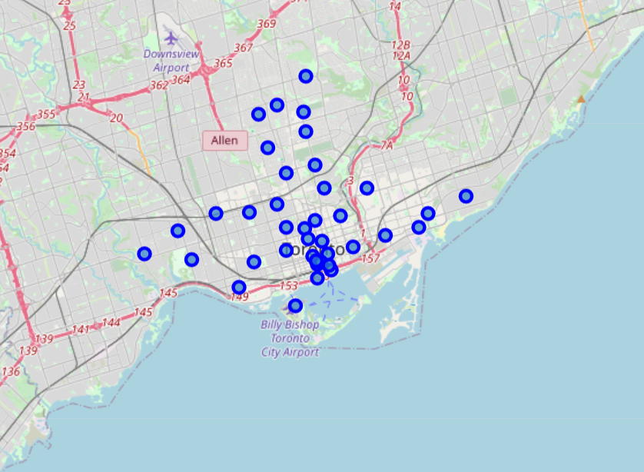
Toronto

Slide 8

Analysis Results
Toronto v.s. New York, which is a better place to open a restaurant?

Slide 9
Analysis Results: Toronto
Cluster 1: This area is the entertainment area, which is full of coffee shops, restaurants, stores, etc.
Cluster 2: This area is the outdoor area, which is full of parks, playgrounds, gyms, etc.
Cluster 3: There is only one neighborhood in this area, where people can find home service, music venues, gardens, etc.
Cluster 4: There is only one neighborhood in this area, where people can find gift shop, breakfast spot, and restaurants, etc.
Cluster 5: There is only one neighborhood in this area, where people can find residence, pub, health food store, etc.

Slide 10
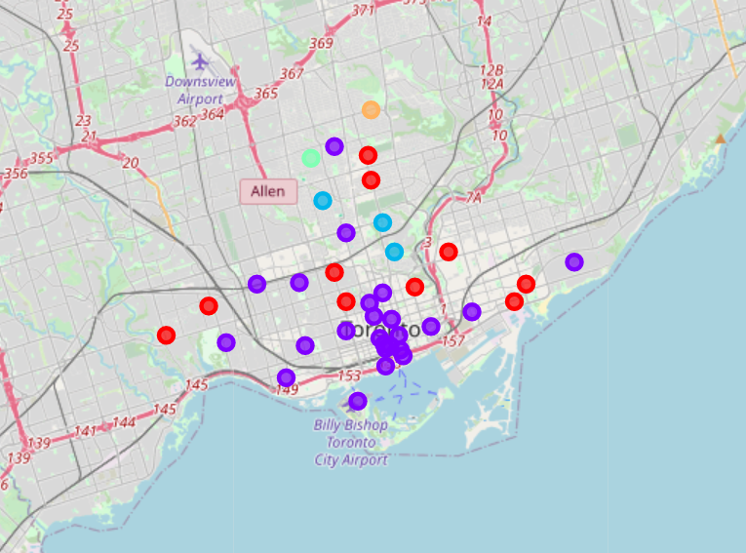
Toronto in Clusters

Slide 11
Analysis Results: New York City
Cluster 1: This area is the entertainment area, which is full of parks, coffee shops, bars, etc.
Cluster 2: This area is the dining area, which is full of restaurants, coffee shops, bars, etc.
Cluster 3: This area is the outdoor area, where people can find boating place, par, pet service, etc.
Cluster 4: There is only one neighborhood in this area, where people can find coffee, gym, discount store, etc.
Cluster 5: This area is another dining area, but the restaurants are mostly Chinese or Mexican restaurant. People can also find cafe, pizza place in this area.

Slide 12
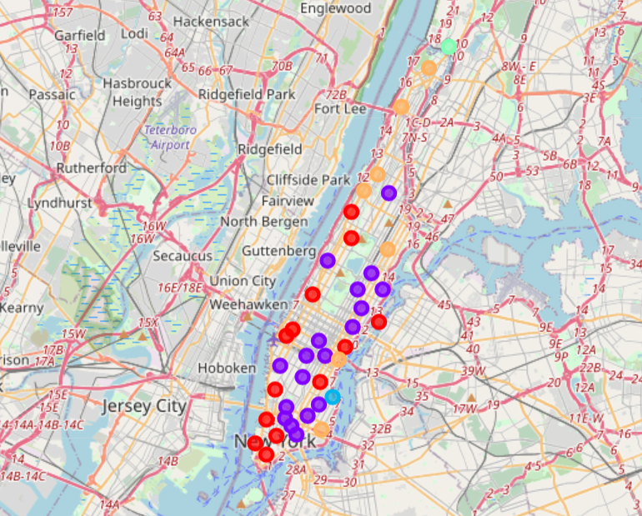
New York City in Clusters

Slide 13

Observation and Recommendations
The best place to open a restaurant in Toronto is Cluster 1, the entertainment area. Because there are already some restaurants and pubs in this area. When people in Toronto want to go to eat, this area is their go-to place.

Slide 14

In New York City, both Cluster 1: the entertainment area and Cluster 2: the dining area are ideal places to open a restaurants. The question is which kind of restaurants, if you want to open an American or Italian restaurants, Cluster 1: the entertainment area is the best choice; if you want to open an Italian or Asian restaurants, Cluster 2: the dining area would be most ideal. In summary, there are more restaurants in Cluster 2 and they are more diversified. So it would be easier to get more customers if you open a restaurant in Cluster 2: the dining area.

Slide 15
Final Conclusion
Comparing Cluster 1 in Toronto with Cluster 2 in New York City, you can find there are more coffee shops and bakery in Cluster 1 of Toronto, and there more restaurants in Cluster 2 of New York City. Therefore it will be easier to get more customers if you chose Cluster 2 to open a restaurants.
In Cluster 2 of New York City, if you are planning to open a Chinese restaurant, Chinatown is the best choice. If you are planning to open an Korean Restaurant, you can chose Midtown South. If you would like to open an Italian restaurant, you can chose Upper East Side, Yorkville, Lenox Hill, etc.

Slide 16

Thanks!

